Slide 1


NAPAfrica Update: SAFNOG 2019 AS37195
PeeringDB Records:
https://www.peeringdb.com/ix/592 https://www.peeringdb.com/ix/597 https://www.peeringdb.com/ix/969

Slide 2

NAPAfrica Update
3 Regions: Johannesburg (750Gbps peak), Cape Town (120Gbps peak), Durban (10Gbps peak)
Members: 420 Unique ASNs, including AS numbers from 26 African countries
Port sizes: 10G/n*10G/100G/n*100G
1062 active ports, 10.2Tbps connected capacity
RPKI ROV on route servers, MANRS Certified

Slide 3
NAPAfrica Transparency
We want our members to know everything about the exchange, to see what we see.
Our looking glass is live for route servers across all regions. Integration to the route collectors (Arista vEOS) is in progress.
We have a live weather map for IX Johannesburg. Cape Town will follow shortly.
We will update the weather map to include additional stats, including CPU/memory, health sensors, and packet breakdown.
We are working on making certain syslog data publicly available.

Slide 4
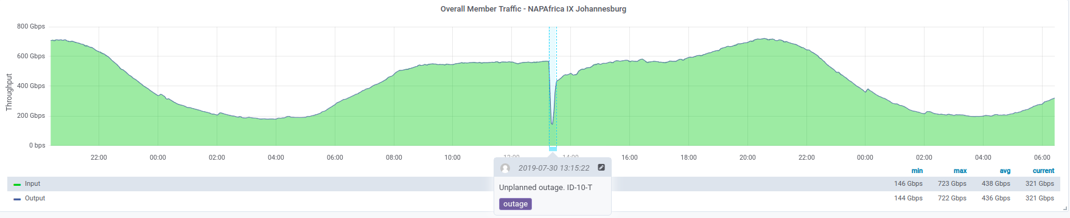
NAPAfrica 2018 Incident
We experienced a brief outage at IX Johannesburg on 30 July at 13:13, which lasted approximately 9 minutes.
This was due to human error.
To prevent this in future, we are investing in an automated provisioning system, which we expect to be live before 2020.

Slide 5
NAPAfrica Community is Key: 2018 Roundtable Ideas
Training Ideas:
NAPAfrica to kick off training opportunities focused on BGP basics, MNRS, filtering and security;
Website:
NAPAfrica to build wiki pages for most commonly required information;
NAPAfrica to include links to large content providers peering polices and peering request forms;
Development & Infrastructure:
NAPAfrica to review building a route map;
NAPAfrica to review the use of RPKI servers;
NAPAfrice to develop a welcome pack to all new members including step by step guide on how to peer;
Peering contacts & general admin:
All welcome notifications to include PeeringDB records and accurate contact information;
NAPAfrica utilises IXP Manager for detailed member contact information;
NAPAfrica to do an audit of which members are not on PeeringDB and then ensure that they are strongly encouraged to register

Slide 6
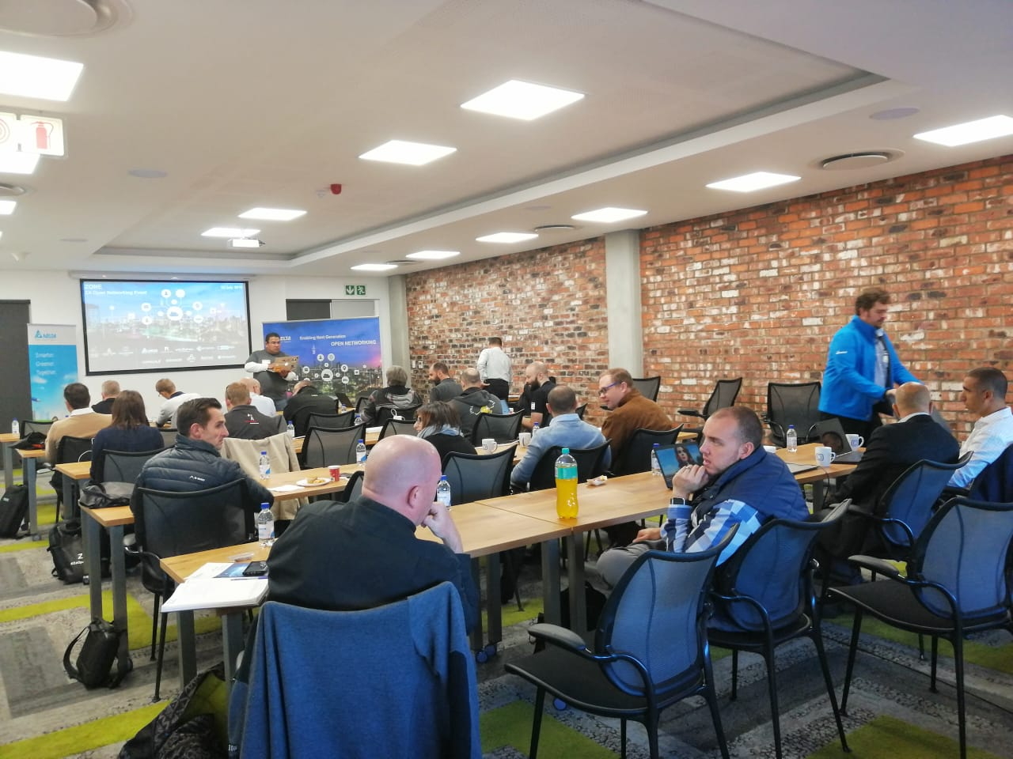
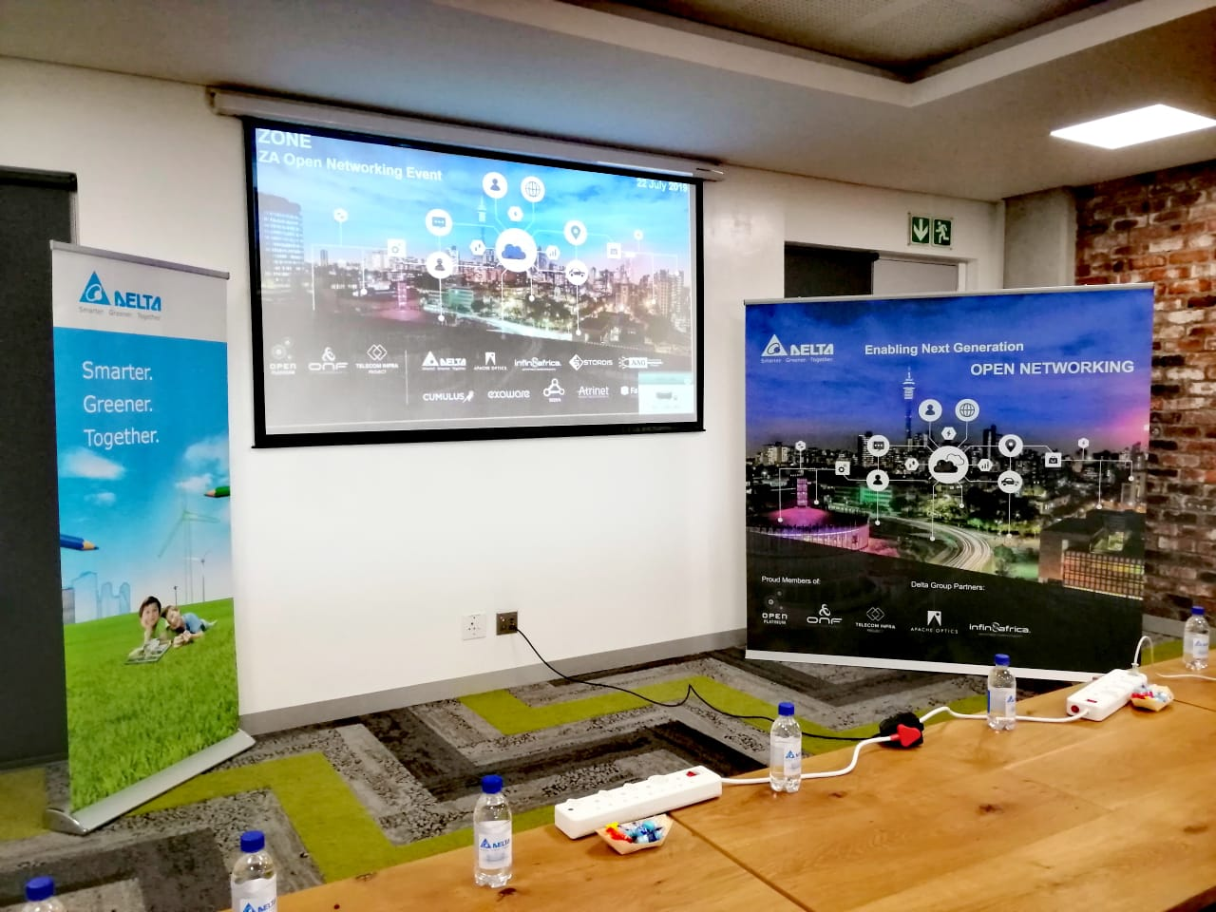
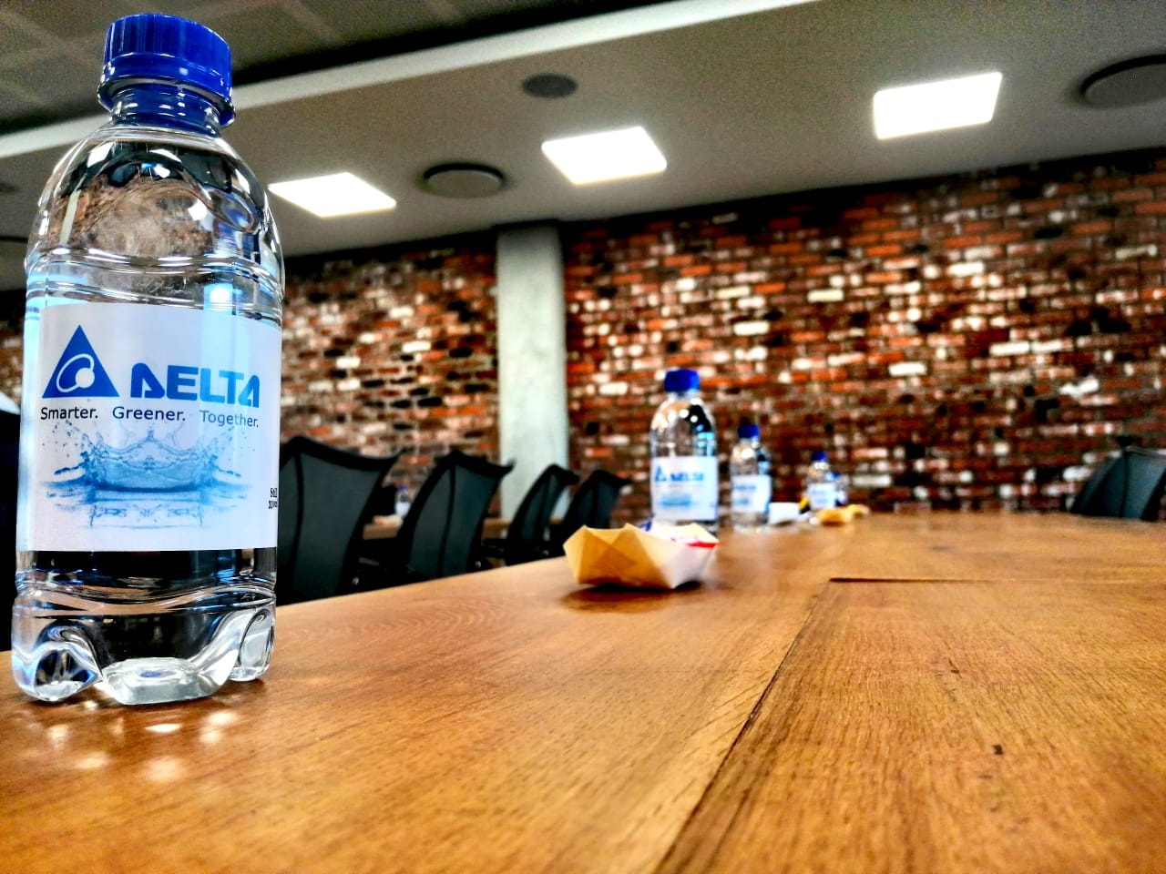
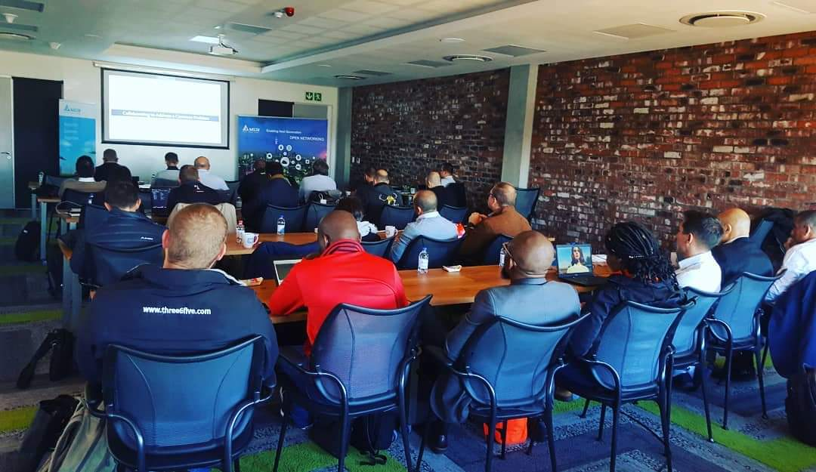
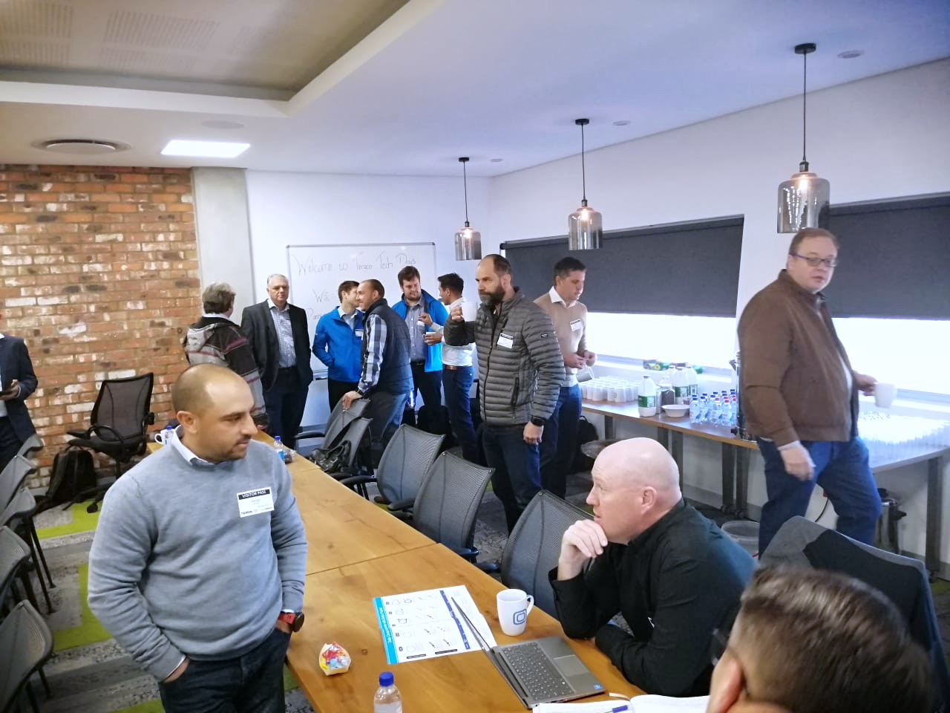
Teraco Tech Days – Closing the technical gap

Slide 7
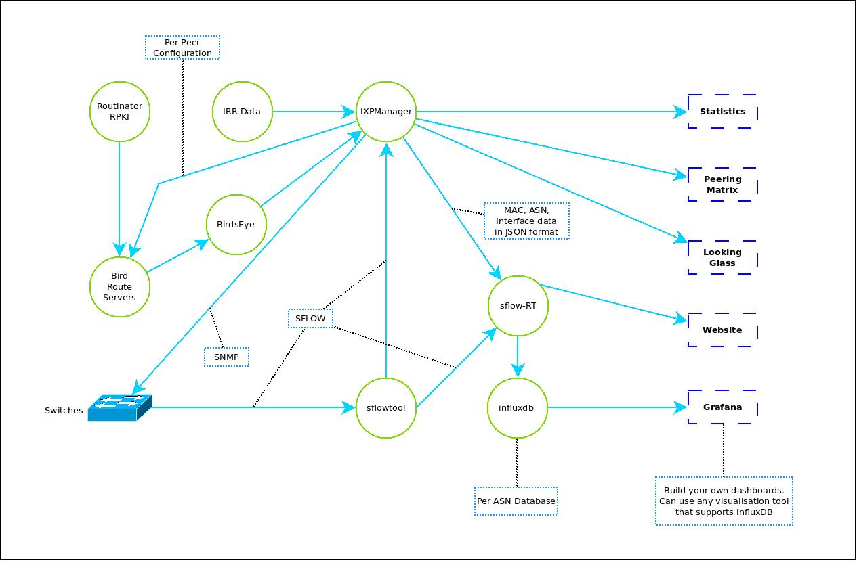
NAPAfrica Data Flow

Slide 8
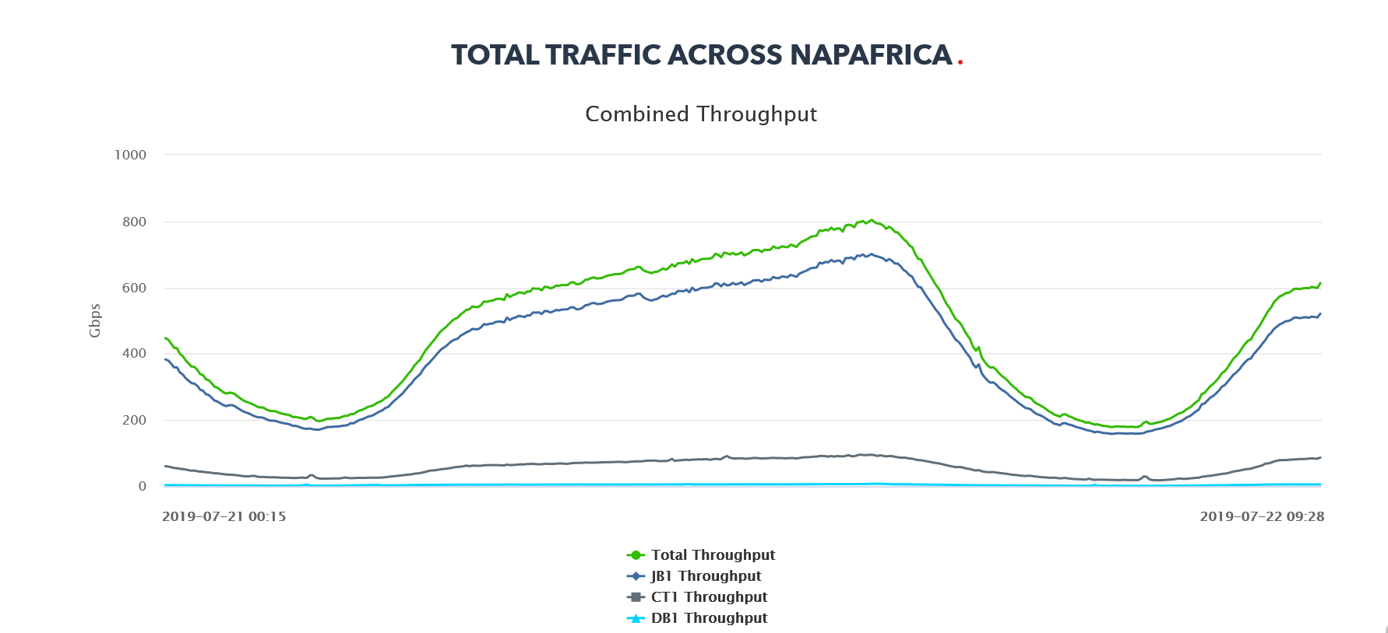
What’s New? Our Up and to the Right Graphs

Slide 9
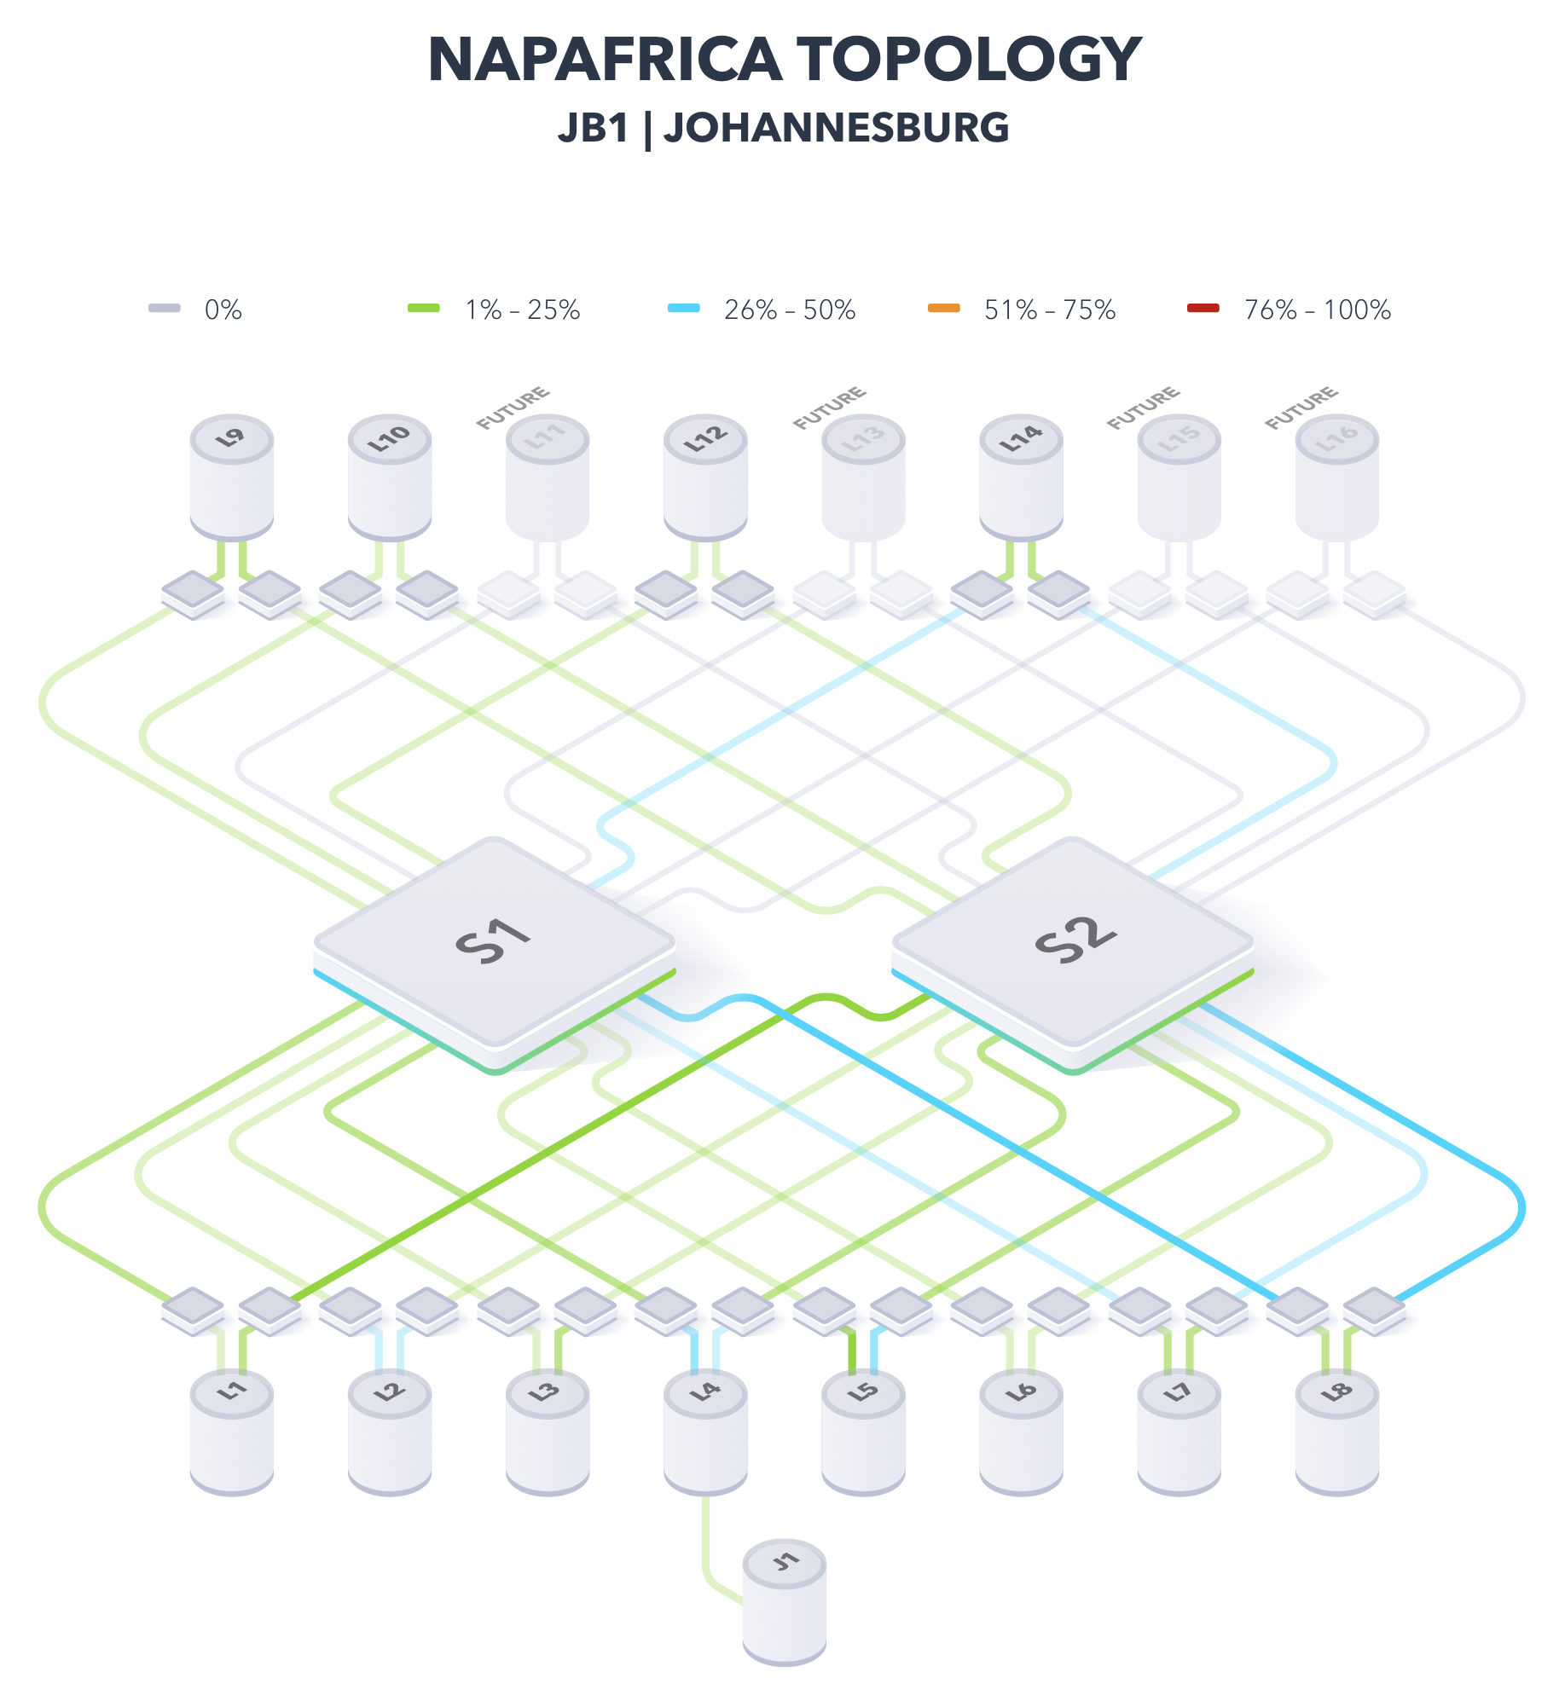
What’s New? The Live Weather Map

Slide 10
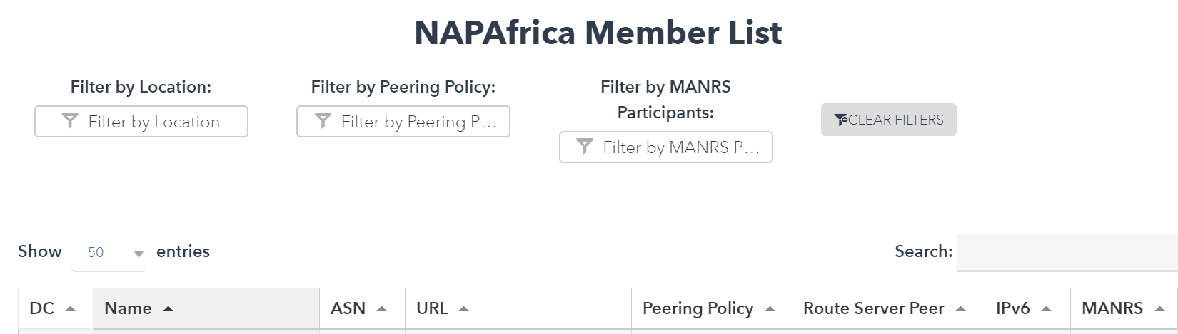
Membership List: Live Member’s List
https://www.napafrica.net/who-is-peering/

Slide 11
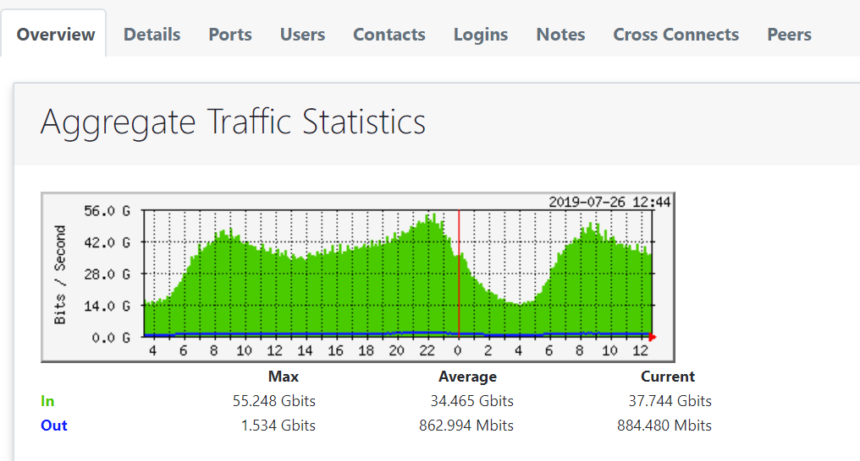
Membership Graphs
Please email nap@teraco.co.za to obtain your user login

Slide 12
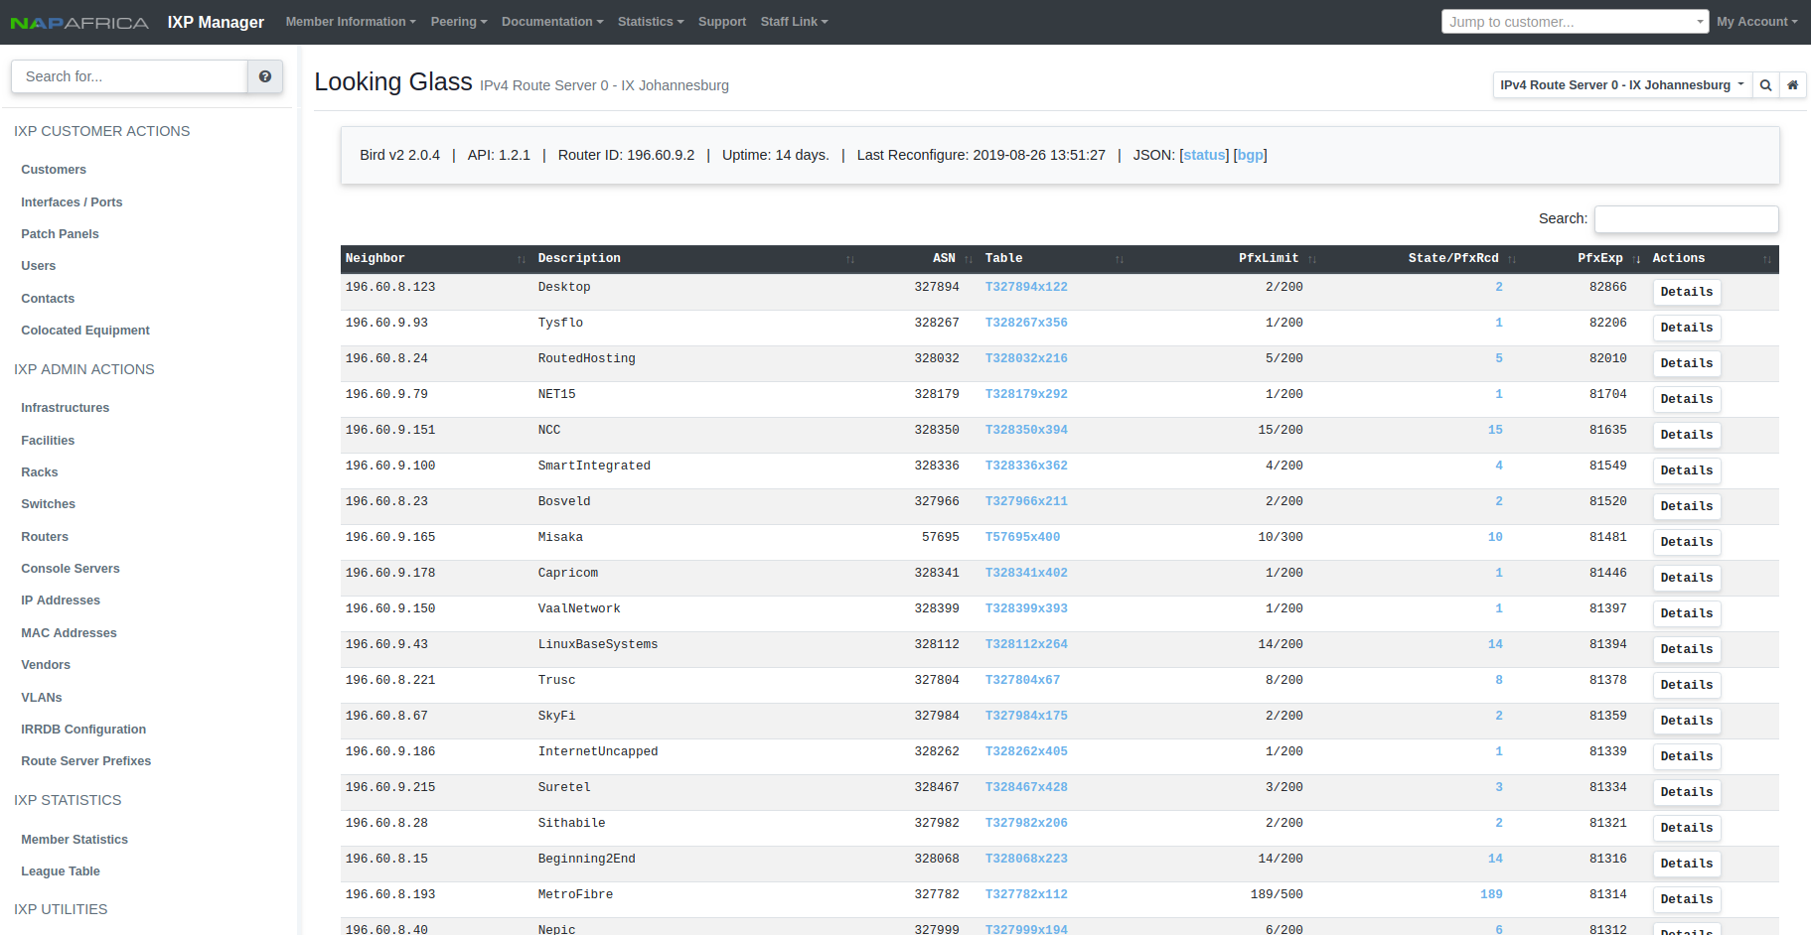
Looking Glass

Slide 13

MANRS: We are members – join the movement
What is MANRS?
The Internet Society’s Mutually Agreed Norms for Routing Security (MANRS) initiative is designed to provide measures to improve the resilience and security of the internet’s routing infrastructure to keep it safe for businesses and consumers.
Why join MANRS?
Improve your security posture and reduce the number and impact of routing incidents
Join a community of security-minded operators working together to make the Internet better
Use MANRS as a competitive differentiator
Visit https://www.manrs.org

Slide 14
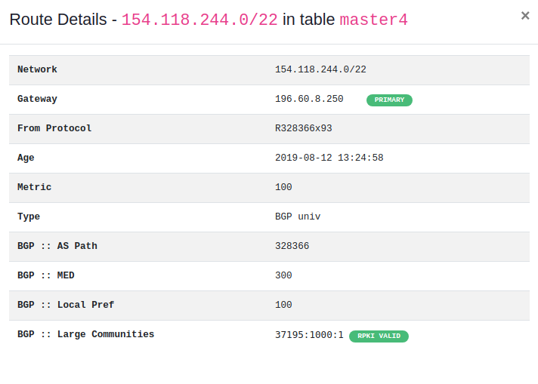
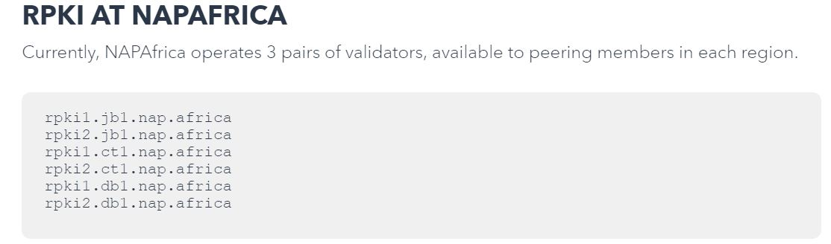
RPKI: We are Validating
https://www.napafrica.net/technical/rpki-handy-hints/
NAPAfrica route servers perform filtering and validation in the following sequence:
Drop prefixes that are too long (/25-/32 for v4 and /49-/128 for v6)
Drop prefixes considered as martians/bogons
Drop prefixes where the AS path length is too short
Drop prefixes where the first AS in the path is not the peer AS
Drop prefixes with well known transit AS numbers in the path
Drop prefixes where the AS path is too long
RPKI Route Origin Validation – Drop invalid prefixes, Accept valid prefixes. RPKI unknowns will be subject to IRR filtering

Slide 15
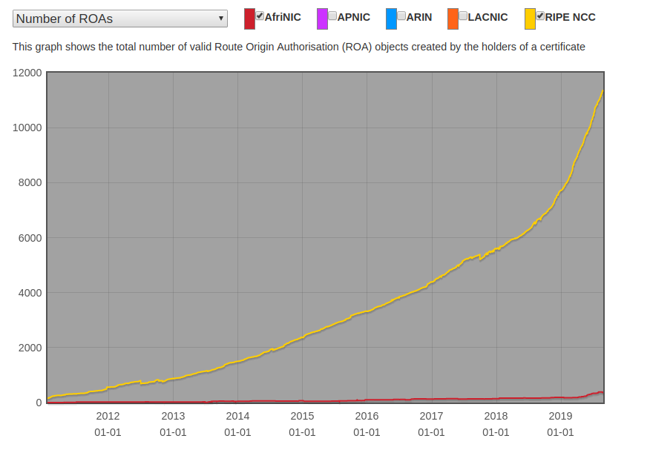
RPKI Uptake: Africa vs World

Slide 16
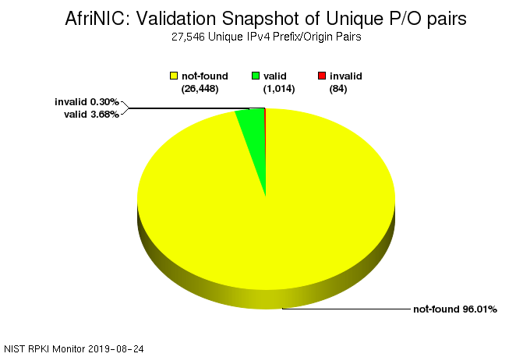
RPKI: the Numbers

Slide 17


And of course… THE CLOUD
11 July 2018
Amazon Web Services (AWS) Direct Connect is now live in South Africa and located at Africa’s only vendor neutral data centre, Teraco. AWS Direct Connect enables clients to directly connect to their AWS resources in an AWS region. The service is accessible via a direct cross-connect within Teraco or from the Teraco Cloud Exchange platform in Johannesburg and Cape Town.
2 November 2017
Teraco Data Environments, Africa’s largest neutral data centre, today announced it will be a Microsoft Azure ExpressRoute Connectivity partner, providing clients high performance private network connections to Microsoft Azure and other Microsoft Cloud Services. Teraco will be one of the first companies to offer access to the Microsoft Azure ExpressRoute sites in Africa, when Azure becomes generally available in 2018.

Slide 18
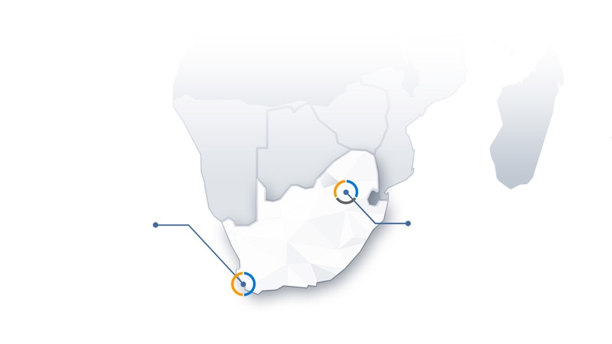

Where are Africa’s Cloud On-Ramp Locations?
CT1 | CAPE TOWN
Region: South Africa West
JB1 | JOHANNESBURG
Region: South Africa North

Slide 19





How to Connect to Africa Cloud Exchange
Public Cloud Services
Virtual private gateway
Public Cloud Services
Virtual private gateway
Cloud On-Ramps
Provider
router
Client router/firewall
Africa Cloud Exchange
CORPORATE DATA CENTER
Public Cloud Services
Virtual private gateway
REGION
CLOUD ON-RAMP LOCATION (TERACO)
JB1 | Johannesburg CT1 | Cape Town
PRIVATE VIRTUAL INTERFACE
PUBLIC VIRTUAL INTERFACE
PHYSICAL CROSS CONNECT

Slide 20
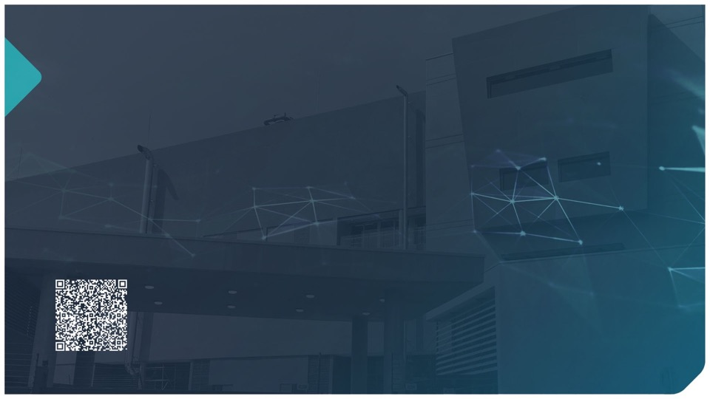
Thank you… any questions?
Email: nap@teraco.co.za or cloud@teraco.co.za
The world connects here.
Teraco Data Environments (Pty) Ltd 5 Brewery Street, Isando, 1600 Phone +27 11 573 2800 / +27 (0) 86 083 7226
www.teraco.co.za

